Slide 1
THE SMART ID CARD
The Ultimate Information Hub
BY JANAKI RAM

Slide 2
Introduction:
An Advanced Smart ID Card is a multifunctional identification card that integrates biometric verification, personal information, government IDs, academic records, health data, and a QR code for comprehensive and secure information management.

Slide 3
Key Components:
Overview of the key components of an Advanced Smart ID Card
Biometric Verification
Personal Information
Government IDs
Academic Information
Health Information
QR Code

Slide 4
Benefits:
Enhanced Security
Efficient Information Access
Academic Tracking
Data Integration
Health Monitoring
Multifunctional Convenience

Slide 5

Biometric Verification:
The process typically involves capturing an individual's biometric information, such as fingerprints, facial features, voice patterns, or iris scans, and converting it into a digital format. This data is then stored securely and used to compare against future biometric scans for verification.

Slide 6

Personal Information:
Detail the personal information included in the card
Name
Photograph
Parents' Names
Address
Blood Group

Slide 7
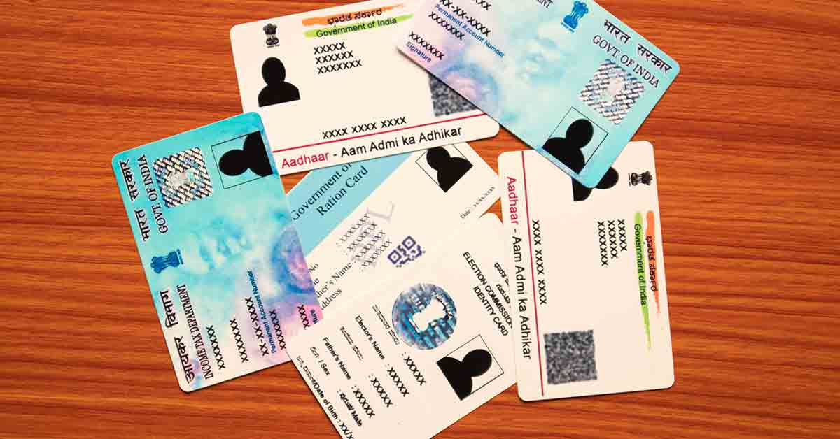
Government IDs
Aadhar Number
PAN Card Number
Voter ID Number
Driving License Details
All bank account details
of a person

Slide 8

Academic Information:
10th marks memo
Inter marks memo
Sports Certificates
NCC/NSS Certificates
Semester Mark lists
Other Course Certificates

Slide 9

Health Information:
Emergency Medical Data
Blood Group
Vaccination Records
Medical Insurance Information
Health Certificates

Slide 10

QR Code:
QR code into a Smart ID Card can enhance its functionality and convenience significantly.
It offers a versatile and efficient way to manage and share data in a secure and convenient manner.

Slide 11

Technology:
Biometric Sensors
QR code generator
ProgrammingLanguages
(Ex:Java,C,Python)
DataBase
(Ex:SQL-Oracle)
Data Storage point
Security Features

Slide 12
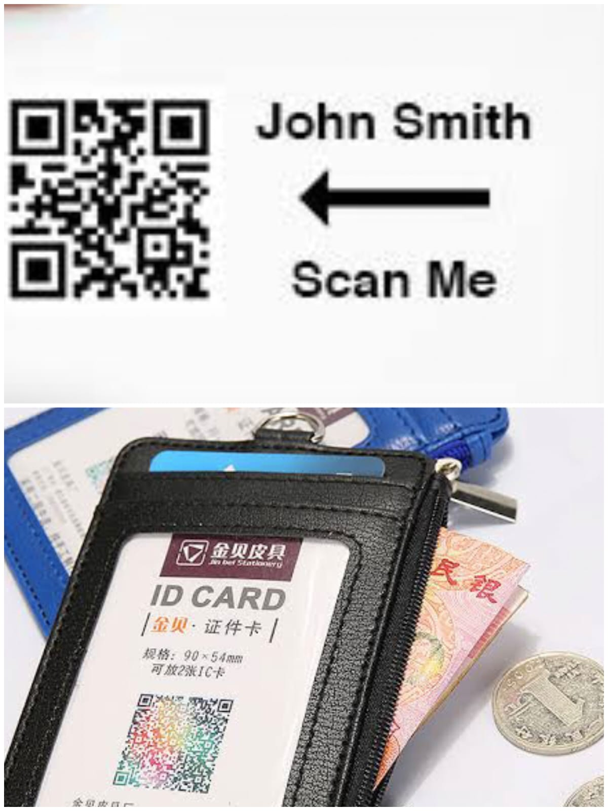
Conclusion:
In conclusion, Smart ID Cards represent a transformative solution that combines convenience and security. By incorporating biometric verification, personal information, academic records, health data, and QR codes, Smart ID Cards optimize efficiency and offer a versatile tool for educational institutions and organizations. Embracing this technology ensures a more streamlined and secure future for identity verification and information management.

Slide 13


